Slide 1

AN LSTM BASED MENTAL HEALTH CLASSIFICATION MODEL
Name :- Patel Vedant Vikrambhai
R.g.no :- 20BCE1779
Guide :- DR. Vinothini A

Slide 2
Outline
Title | Slide Number
Introduction | 3
Problem Statement | 4
Research Objective | 5
Proposed System | 6
Proposed System Diagram | 7
List of Modules | 8
Modules | 9-18
Result | 19-25
What is to be done next | 26
Guide Approval mail snapshot | 27
Research Paper Status | 28
References | 29-30

Slide 3
Introduction
According to the World Health Organisation (WHO), over 800 million people of all ages suffer from depression due to various mental health issues.
Studies reveal that shame and self-stigmatisation were the main reasons for not seeking psychiatric help for depression.
However, recent advances in technology especially in natural language processing (NLP) have presented the world with various application-based and online diagnosis tools where the patient can be diagnosed from the comfort of their own home.
Woebot, Wysa, Joyable and Talkspace are a few examples of chatbots that are available as Android/iOS apps or websites that can perform mental health assessments using natural conversation.
Although these systems are good at providing general therapeutic advice, they do not replace the role of a psychiatrist.
However, such systems allow preventive measures and early diagnosis of mental health issues to avoid their increasing severity. self-stigmatization.

Slide 4

Problem Statement
Sentiment analysis algorithms and conversational agents are being leveraged to create a supportive platform that encourages individuals to share their emotional concerns. The project is developed an Ai based system that could classify the emotion of humans into various mental health disorders.
The goal is to integrate cutting-edge technology with mental health care to promote early intervention and improve mental health outcomes for individuals worldwide.

Slide 5
Research Objective
To design an AI model by using sequence modeling in NLP to classify user written text into various categories of mental health issues.
Deploy the development AI model in real time environment.

Slide 6
Proposed System
Data collection and annotation: The next step is to collect a large dataset of text data that will be used to train the LSTM model. This involves collecting data from a variety of sources, such as social media, online forums, and healthcare records, and annotating it with labels that indicate the presence or absence of each mental health issue.
Preprocessing: The collected text data must be preprocessed to remove noise, standardize language use, and convert it into a format that can be used by the LSTM model. This may involve techniques such as tokenization, stemming, and lemmatization.
Model development: The LSTM model is then developed using the preprocessed text data. This involves selecting appropriate hyperparameters, training the model on the labeled data, and evaluating its performance using appropriate metrics such as precision, recall, and F1 score.
Deployment: Once the LSTM model has been developed and evaluated, it can be deployed in a production environment. This may involve integrating the model into an existing mental health screening tool, developing a standalone application, or integrating it into an electronic health record system.

Slide 7
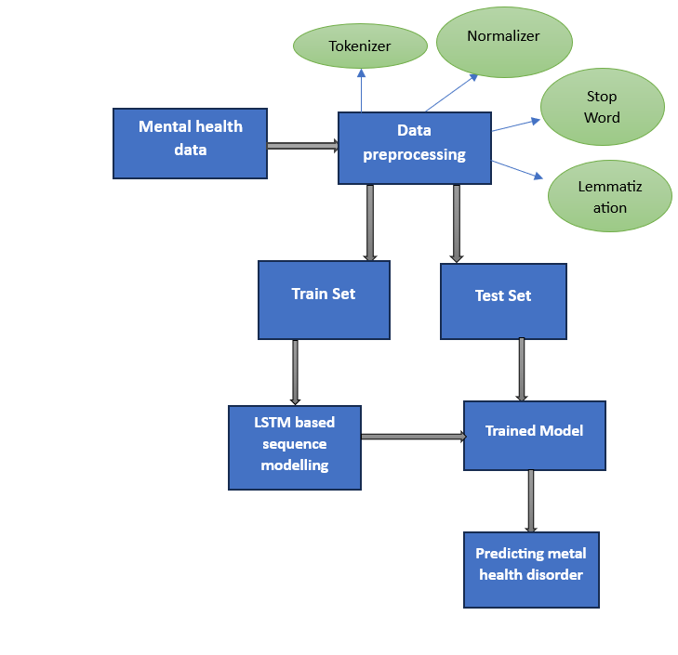
Proposed System Diagram

Slide 8

List of Modules
1. Data Collection and Preprocessing
Word embedding
Tokenization
Stemming
Lemmatization
Part of speech tagging
Normalizer
Stop words Removal
2. LSTM Model Training
3. Hyperparameter Tuning
4. Performance Evaluation

Slide 9
Modules
1. Data Collection and Preprocessing:
Data Collection: Gather a diverse dataset containing text samples related to mental health. This can include forums, social media posts, clinical notes, etc.
Text Cleaning: Preprocess the text data by removing irrelevant information, special characters, and performing tasks like stemming or lemmatization.
Tokenization: Break down the text into individual words or tokens.
Word Embeddings:
Word Embedding Layer: Convert words into numerical vectors to represent semantic relationships. Techniques like Word2Vec, GloVe, or pre-trained embeddings (e.g., Word2Vec, GloVe, or embeddings from transformer models like BERT) can be used.

Slide 10
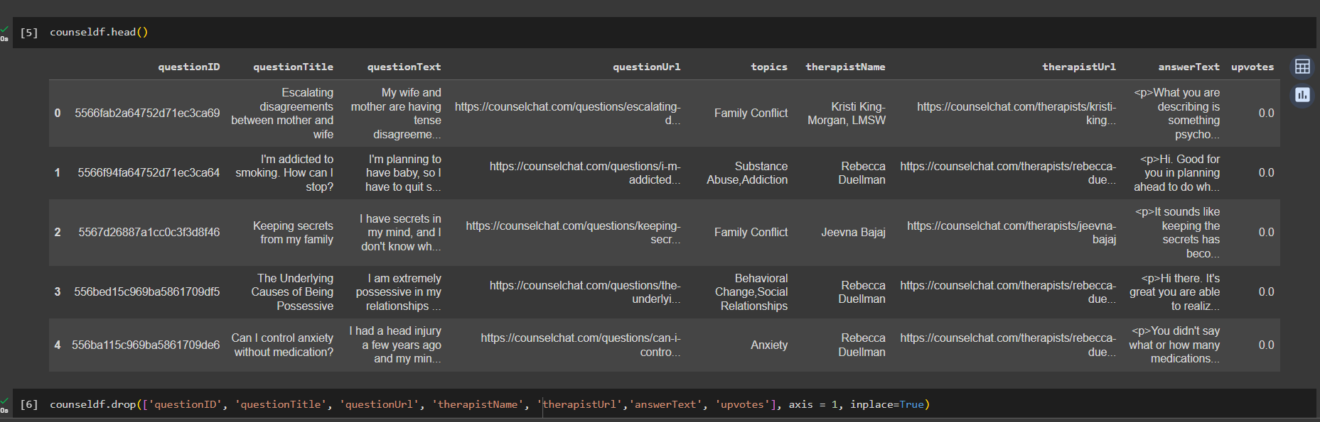
Modules

Slide 11
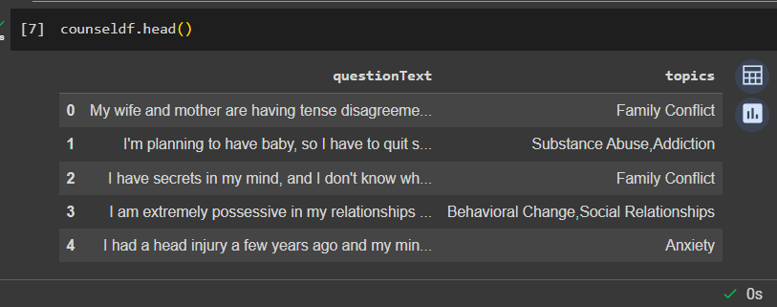
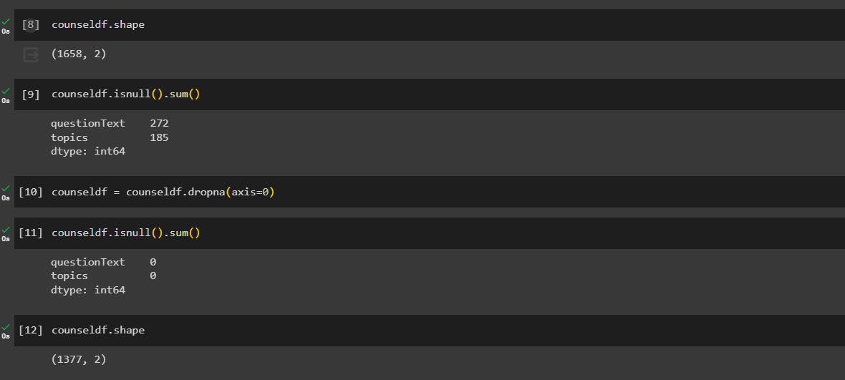
Modules

Slide 12
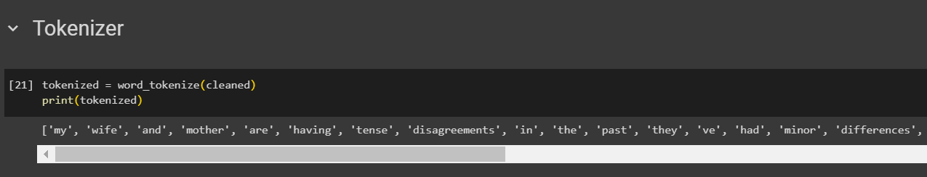
Modules
Tokenization
Tokenization breaks text into smaller parts for easier machine analysis, helping machines understand human language. Tokenization, in the realm of Natural Language Processing (NLP) and machine learning, refers to the process of converting a sequence of text into smaller parts, known as tokens.

Slide 13
Modules
Stemming
Stemming is a technique used to extract the base form of the words by removing affixes from them. It is just like cutting down the branches of a tree to its stems. For example, the stem of the words eating, eats, eaten is eat.
Lemmatization
Lemmatization is a text pre-processing technique used in natural language processing (NLP) models to break a word down to its root meaning to identify similarities. For example, a lemmatization algorithm would reduce the word better to its root word, or lemme, good.
Part of speech tagging
The process of marking up a word in a text (corpus) as corresponding to a particular part of speech, based on both its definition and its context.

Slide 14
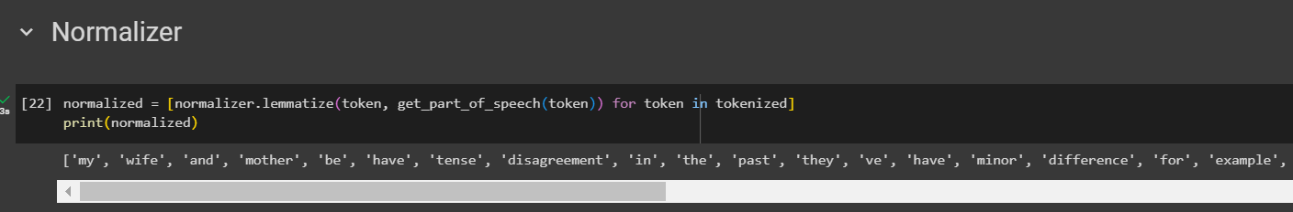
Modules
Normalizer
Normalization helps you keep your database organized. It reduces the duplication of data and improves its integrity. In its first normal form, the relation consists of unique values with no-repeat values. The second normal form eliminates all partial dependencies.

Slide 15
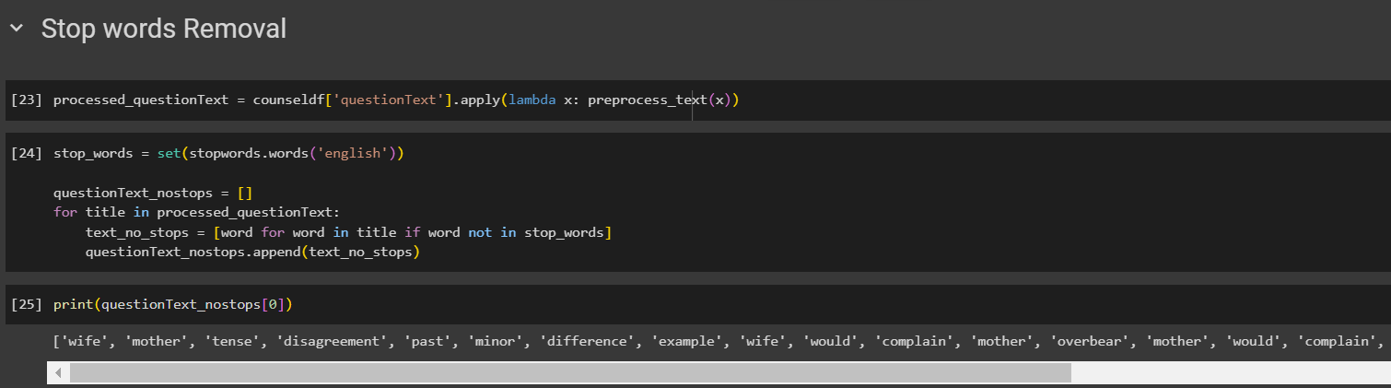
Modules
Stop words Removal
The idea is simply removing the words that occur commonly across all the documents in the corpus. Typically, articles and pronouns are generally classified as stop words.

Slide 16
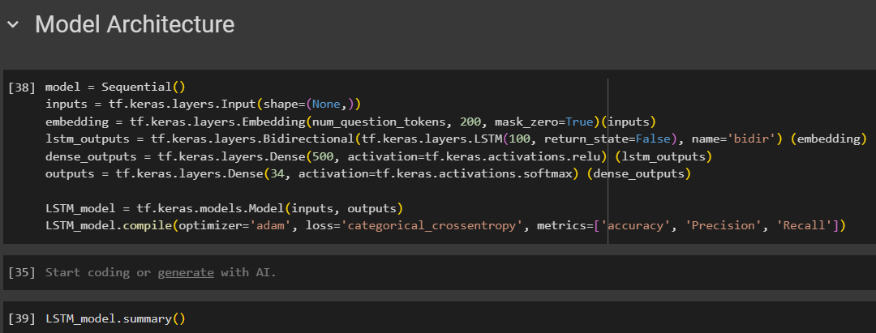
Modules
2. LSTM Model Training:
Loss Function: Define a suitable loss function for your classification task (e.g., binary cross-entropy for binary classification or categorical cross-entropy for multi-class classification).
Optimizer: Choose an optimizer such as Adam or RMSprop.
Training: Train the model on your dataset, monitoring performance on a validation set.

Slide 17
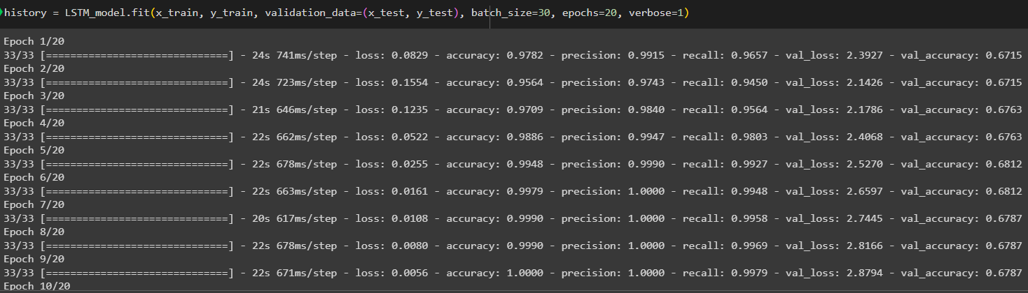
Modules
3. Hyperparameter Tuning:
Grid Search or Random Search: Experiment with different hyperparameter values (e.g., learning rate, dropout rate, LSTM units) to optimize model performance.

Slide 18
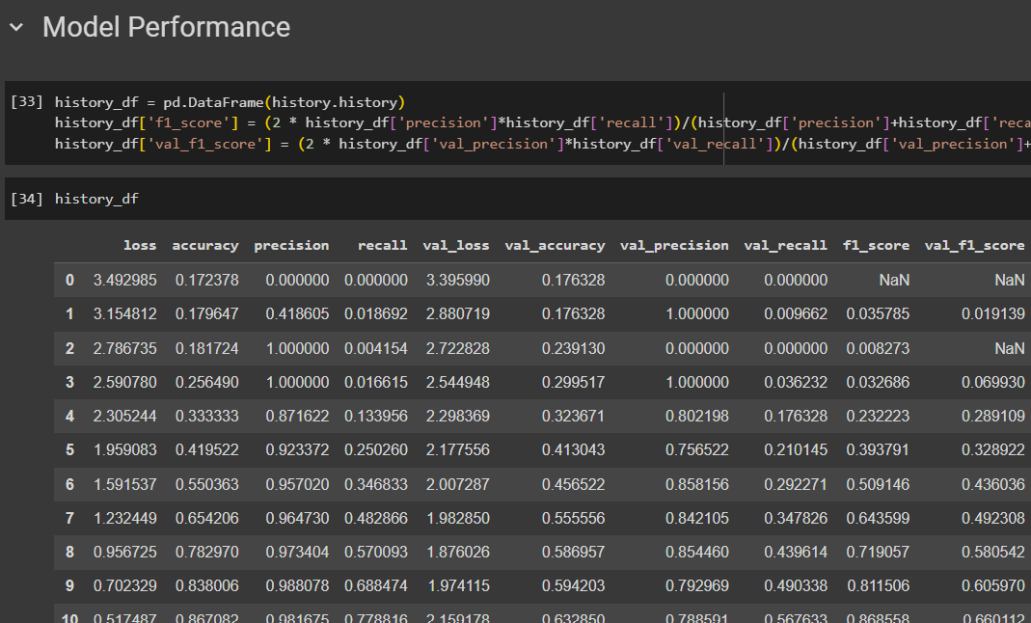
Modules
4. Evaluation Metrics:
Accuracy, Precision, Recall, F1 Score: Evaluate the model's performance using appropriate metrics for classification tasks.
Confusion Matrix: Analyze false positives, false negatives, true positives, and true negatives.

Slide 19
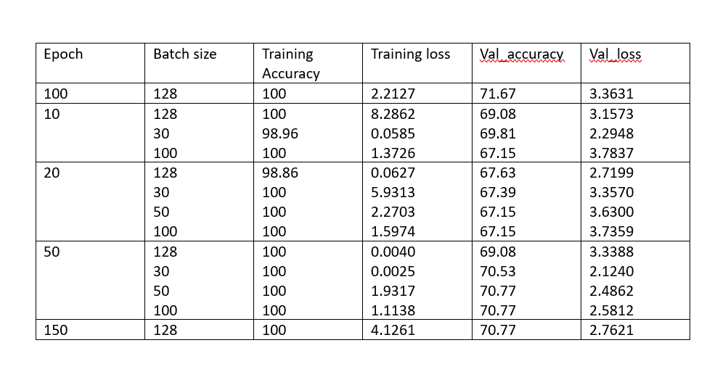
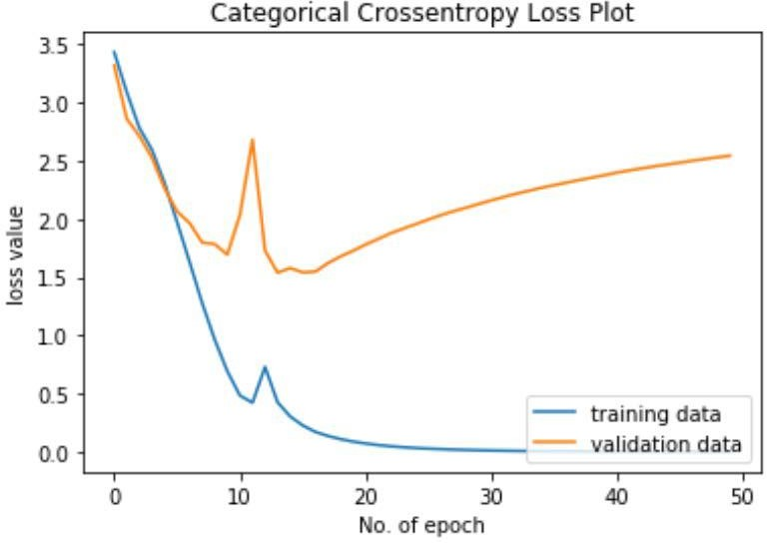
Result
LSTM training
The model was trained for 50 epochs. The training accuracy continuously increased and ultimately reached 100%. However, the test accuracy stabilized at approximately 72%. This is a great result considering the size of the dataset. It is possible that with more data, the test accuracy could be increased further since there will be more word tokens available for the network to rely on.
The graph for the loss plot is presented in Fig. As shown in this figure, the model starts to overfit to the training data just before 20th epoch. The lowest point for validation loss is considered the optimum point.

Slide 20
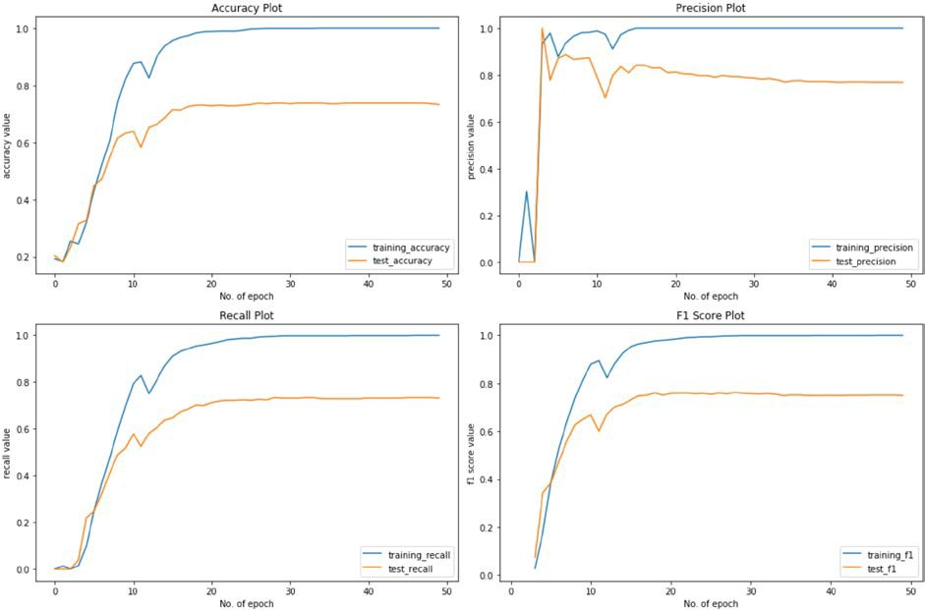
Result
Several classification metrics were applied to the results and the graphs are presented in Figure b

Slide 21
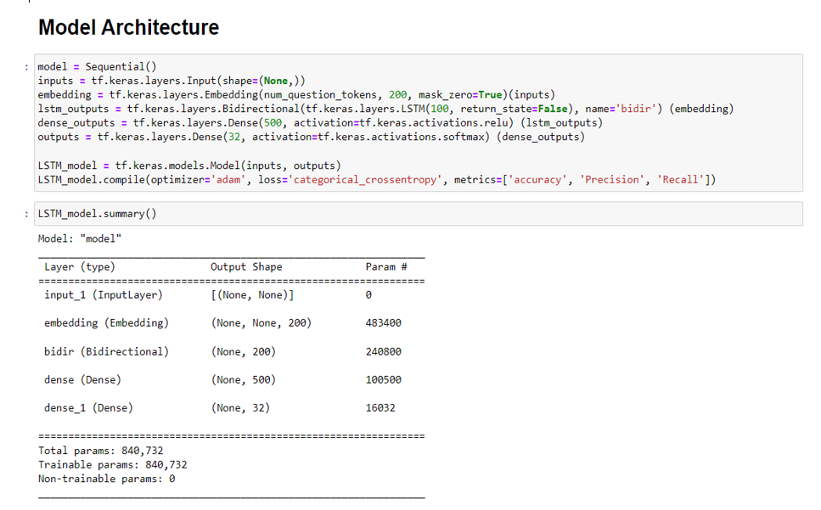
Result
The plots shown in Figure b indicate that the model adopts a smooth convergence around 20th epoch. This is further supported by the precision, recall and F1 score plots, which indicate that the model can truly identify the classes.
MODEL ARCHITECTURE

Slide 22
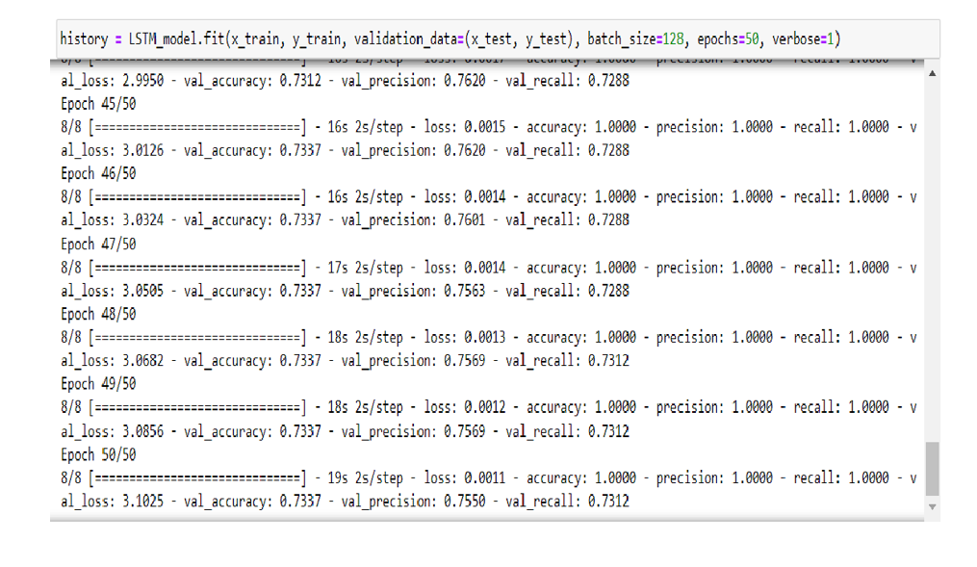
Result

Slide 23
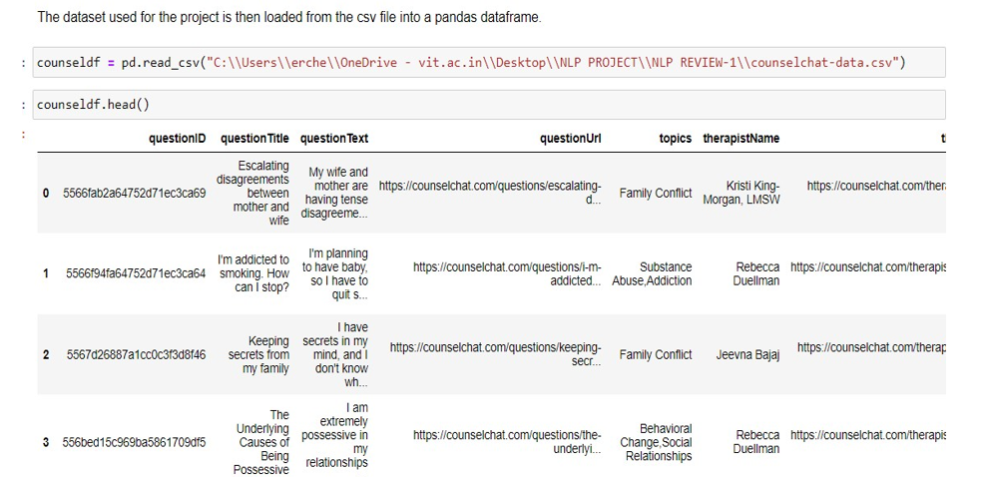
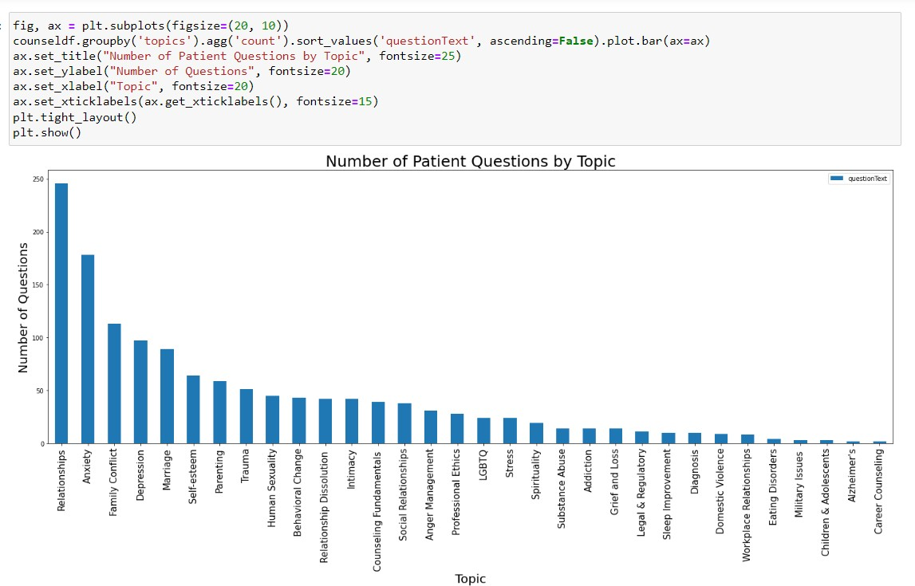
Result
Loading and Preprocessing Dataset

Slide 24
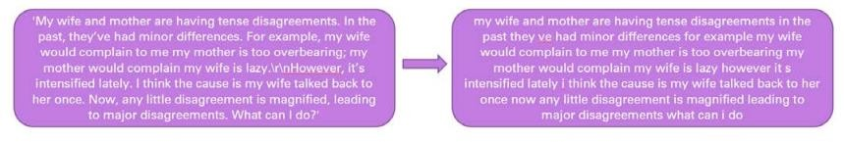
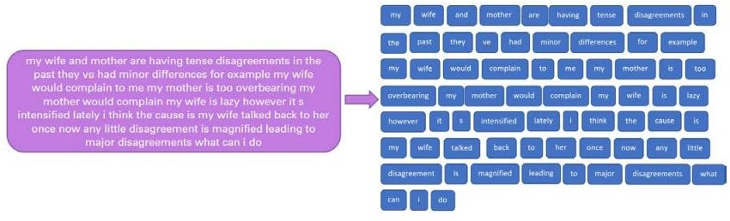
Result
NOISE REMOVAL
TOKENIZATION

Slide 25
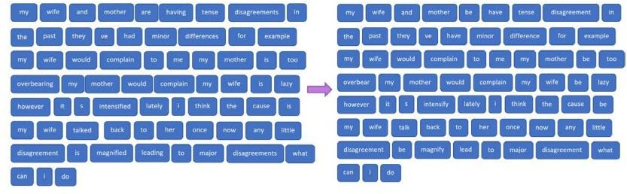
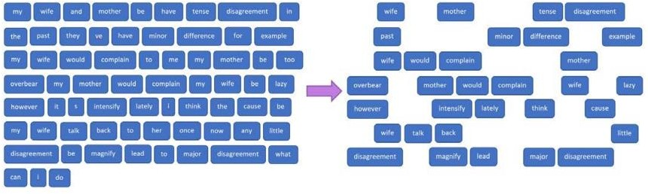
Result
LEMMATIZATION
STOP WORDS REMOVAL

Slide 26


What is to be done next
100% Implementation.
Result and discussion in the Research Paper.
This Photo by Unknown author is licensed under CC BY-NC-ND.
This Photo by Unknown author is licensed under CC BY-SA.

Slide 27
Guide Approval mail snapshot

Slide 28

Research Paper Status
Till now, I have written Abstract, Introduction, Literature Survey, and Methodology.

Slide 29

References
B. Shickel, M. Heesacker, S. Benton and P. Rashidi, "Automated Emotional Valence Prediction in Mental Health Text via Deep Transfer Learning," 2020 IEEE 20th International Conference on Bioinformatics and Bioengineering (BIBE), Cincinnati, OH, USA, 2020.(IEEE)
Dongkeon Lee, Kyo-Joong Oh and Ho-Jin Choi, "The chatbot feels you - a counseling service using emotional response generation," (BigComp), Jeju, Korea (South), 2021.(IEEE)
Syarif, N. Ningtias and T. Badriyah, "Study on Mental Disorder Detection via Social Media Mining," 2019 4th International Conference on Computing, Communications and Security (ICCCS).2022(IEEE)
Y. Aryal, A. Maag and N. Gunasekera, "Application of Machine learning algorithms in diagnosis and detection of psychological disorders.(IEEE)-2020
Tanya Nijhawan, Girija Attigeri & T. Ananthakrishna,Stress detection using natural language processing and machine learning over social interactions, 2022(Springer)
Aziliz Le Glaz, Yannis Haralambous, Deok-Hee Kim-Dufor,1 Philippe Lenca, Romain Billot, Taylor C Ryan, Jonathan Marsh, Jordan DeVylder, Michel Walter,1, Sofian Berrouiguet, Christophe Lemey,Machine Learning and Natural Language Processing in Mental Health,2021(Jounral of medical internet research )
Young, T., Hazarika, D., Poria, S. and Cambria, E., 2018. Recent Trends in Deep Learning Based Natural Language Processing, ArXiv, 2020(IEEE)

Slide 30
References
8. M. Hoogendoorn, T. Berger, A. Schulz, T. Stolz and P. Szolovits, "Predicting Social Anxiety Treatment Outcome Based on Therapeutic Email Conversations," in IEEE Journal of Biomedical and Health Informatics, vol. 21, no. 5, pp. 1449-1459, Sept.(2022)
9. Tholusuri, A., Anumala, M., Malapolu, B. and Lakshmi, G.J., 2019. Sentiment Analysis using LSTM, International Journal of Engineering and Advanced Technology, 8(6S3), pp. 1338 1340.(IJEAT)
10. Su, M., Wu, C., Huang, K and Hong, Q., 2018. LSTM-based Text Emotion Recognition using Semantic and Emotional Word Vectors, First Asian Conference on Affective Computing and Intelligence Interaction,2020(ACII Asia)
11. Mikolov, T., Chen, K., Corrado, G. and Dean, J., 2013. Efficient Estimation of Word Representations in Vector Space, ArXiv,2020 (IEEE)
12. Li, S., 2019. Multi-Class Text Classification with LSTM, 2020(IEEE).
Karpathy, A., 2015. The Unreasonable Effectiveness of Recurrent Neural Networks. Andrej Karpathy Blog,2021(IJEAT)
14. Bigi, B., 2014. A multilingual text normalization approach. Human Language and Technology Challenges for Computer Science and Linguistics, vol. LNAI-8387, pp. 515-526(IEEE) -2020
15. Bertagnolli, N., 2020. Counsel Chat: Bootstrapping High-Quality Therapy Data, 2023(IJEAT)
Data Set Link :- Counselchat.com counselling data provided by the founders to Nicolas Bertagnoli.

Slide 31

Thank you

